Slide 1
Robust Programs
Lesson 2

Slide 2
Starter
Log on
Open Practice Controlled Assessment
Make sure that the following section are completed
Analysis
Success Criteria
Design
Flowchart
Pseudocode
Variable and Validation

Slide 3
Starter
For each letter of the Alphabet write down one test that begins with that letter.
For example
D Driving Test
G GCSE exam

Slide 4
Learning Intentions
Understand the purpose of testing
Identify different types of program errors
Know the difference between iterative and terminal testing
Be able to select suitable test data
Keywords
Iterative testing
Syntax Errors
Logic errors
Final/terminal testing
Test Data

Slide 5
Program errors, what is the worst that could happen?
https://www.youtube.com/watch?feature=player_embedded&v=8oI_laHhGjE

Slide 6
Programs Errors
What errors have you come across?
Could the Heartbleed have bee avoided?
Who is responsible for the Heartbleed bug?

Slide 7
The Twitter Bug
http://www.bbc.co.uk/news/technology-35361150
Discuss this article

Slide 8
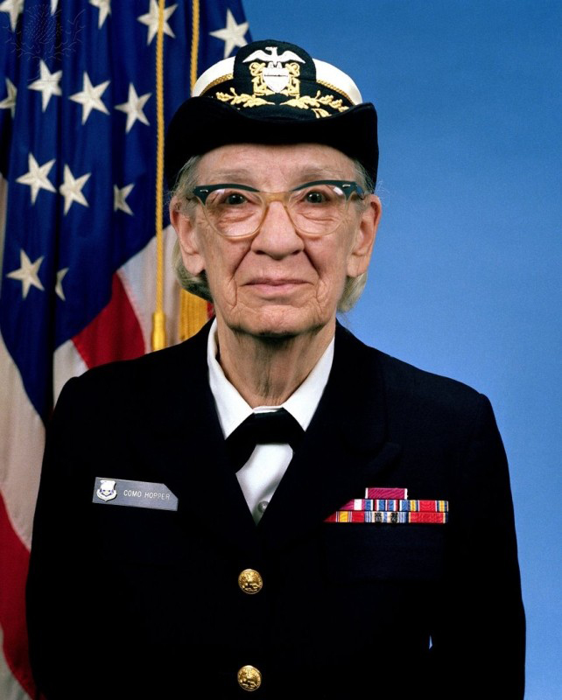
What is a Error
An error in a program is sometimes called a Bug
This is because Grace Hopper discovered a moth in a computer which was stopping it from functioning correctly.

Slide 9
What is a Error
Bugs cause the program to run incorrectly and are usually caused by an error in the coding
Not all errors will stop a program from running

Slide 10
Activity
Look at the code on the following slide
There are some errors/bugs
Can you identify what they are.
Check with another student and compare to see if you have found them all.

Slide 11
Debug this Pseudocode There are three errors
number 1 = int(input(“Please enter a number”))
number 2 = int (input (“Please enter another number)
Sum = number 1 / numBer 2
print (Summ)

Slide 12
Activity 1 - Answer
number 1 = int(input(“Please enter a number”))
number 2 = int(input (“Please Enter another number”))
Sum = number 1 / number 2
print (Summ)

Slide 13
Runtime Errors
Runtime errors are errors which may cause program errors or the computer to crash even if there appears to be nothing wrong with the program code.
They are only detected once the program is executed
Examples could be: Running out of memory

Slide 14
Syntax Errors
Syntax errors are mistakes in the way that the code is written.
Translators can only execute a program if it is syntactically correct.
Common syntax errors include:
spelling mistakes
incorrect use of punctuation
-use of capital letters

Slide 15
Logic Errors
Logic errors: a logic error is a bug in a program that causes it to operate incorrectly, but not to terminate or crash.
A logic error produces unintended or undesired output or other behaviour, although it may not immediately be recognised.

Slide 16
Activity 2
Look back at the code from the previous task and consider each error.
Classify them as either Syntax or Logic errors. Make sure you can justify your answer.

Slide 17
Activity 2 – Identify and define the errors for dividing two numbers
number1 = int(input(“Please enter a number”))
output 2 = int(input (“Please enter another number”))
sum = number1 * Number2
print (sum)

Slide 18
Activity 2 - Answer
number1 = int(input(“Please enter a number”))
output2 = int(input (“Please enter another number”))
Sum = number1 * Number2
print (sum)
SYNTAX
LOGIC AND SYNTAX
SYNTAX

Slide 19
Types of Testing
Iterative testing is testing the code as you create it.
This could completed line by line or a section at a time.
Once tested and feedback is received you then alter your code as required.
You could consider this type of testing similar to tuning a guitar.
You keep playing the string and adjusting the tension until the note is the correct pitch.

Slide 20
Types of Testing
Final or Terminal testing is carried out at the end of the program when it has been written.
This is more similar to the GCSEs which are taken at the end of the term.
It is used to check what happens when a range of predefined test data is entered or used in the program

Slide 21
Selecting and using Suitable Test Data
When testing the program it is important to use a range of test data
valid/in range
out of range
boundary value
null value
invalid

Slide 22
Selecting and using Suitable Test Data
Valid – Data that is correct
In Range – The maximum values of the data that could be entered for example for teenagers 13 - 19
Out of Range – Values higher or lower than the expect range, for teenagers greater than 19
Null Value – when no data is entered or left blank to test what happens.
Invalid - incorrect values such as entering ‘Dave’ in an age field.

Slide 23
Test Plans
Testing is often completed in a test plan which sets out
The test number
Purpose of Testing
The test data entered
The type of test
The expected outcome
The result of the test
Action required as a result of the test

Slide 24
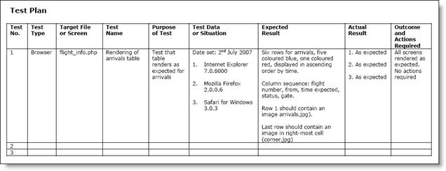
Test Plans
http://www.sqa.org.uk/e-learning/IMAuthoring03CD/images/pic001.jpg

Slide 25
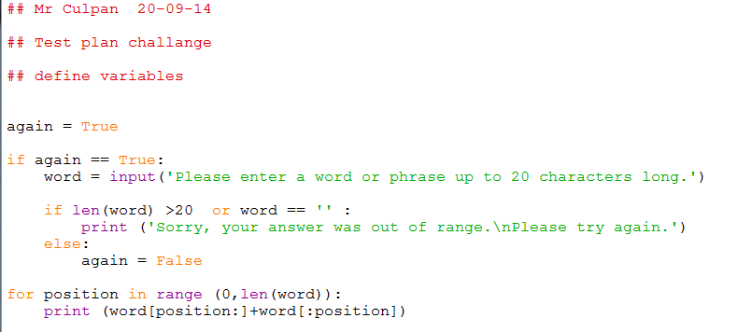
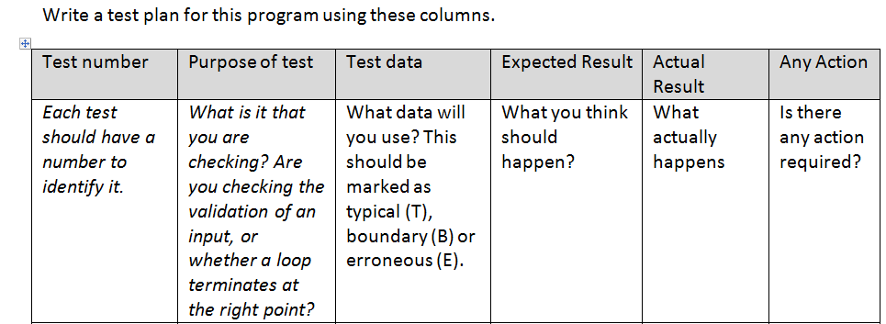
Test Plan Activity

Slide 26
Starter
Write a short description of the following in your book or PowerPoint
Iterative testing
Final/terminal testing
Syntax Errors
Logic errors
Test Data

Slide 27
Controlled Assessment Type Task
Analyse, design, develop test and evaluate a program which has a menu system that gives the option of selecting one of three actions:
When this option is selected, the program should prints the 10 times table
When this option is selected, the program should tells you how you are feeling by picking a statement (from a set that you have added) at random
When this option is selected, the program should display your name and address (try programming this with both local and global variables)

Slide 28
Task 1 – Analysis
Analyse
I have been ask to create a system that gives the user option to select one of three options; as follows;
10 times table
Random feeling
Name and Address
I am going to create a procedure for each of the above options
Option 1:
When this option is selected, the program called the procedure that prints the 10 times table.

Slide 29
Task 1 – Success Criteria
Success Criteria
For my program to be successful it will need to meet the following criteria;
The program must have a procedure that calculate and display the 10 timetables
The program must have a procedure that pick a random feeling from a pre-define feelings
The program must have a procedure that display name and address.
The program must output a message that prompt the user to make a choice of what they want the program to display
The program must allow the user to enter one of the three their options
The program must be able to output the user option. For example if option 1 is selected, the program must display the 10 timestable

Slide 30
Task 1 – Design
Flowchart
Start timetable
i = 1 to 10
i “ x 10 is “ + 1 * 10
End timetable
Pseudocode
Define timetable Function
For I in RANGE (10)
OUTPUT (I & “x 10 is ” & 1*10
End Function

Slide 31
Task 1 –Variables and Validation
Possible Variables and Validation
Variable Name | Data Type | Validation | Description
choice | Integer | Must be a value between 1 and 4 | This is the variable that hold the user choice entered.

Slide 32
Task 1 –Test Plan
Test Plan
Test No. | Purpose of Testing | How | Test Data | Expected Result | Actual Result | Any Action
1 | Testing to see if the program has a procedure that calculate and display the 10 timetables | Run the Code | none | I expect the program to display the 10 timetables | The program displays the 10 timetables | None is required

Slide 33
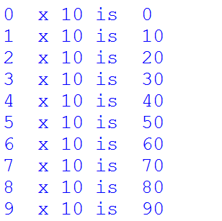
Result of Testing
Result 1
Testing to see if the program has a procedure that calculate and display the 10 timetables
As you can see on the screenshot below the code above works correctly

Slide 34
Evaluation
Description of the Task
Describe the task
Describe what you did
Good Points
List down all the criteria you met
Limitations
Describe all the limitation of the program
Describe limitation of the software
User Feedback
Feedback from your target audience
Future Improvement
Describe all improvement based on the limitation and user feedback

Slide 35
Plenary
Share with another students three new elements that you have learnt this lesson
Open a program that you have written and test it for errors.
Identify the errors in term so f syntax or logic
Create an example of a logic error in a programing language of your choice

