Slide 1
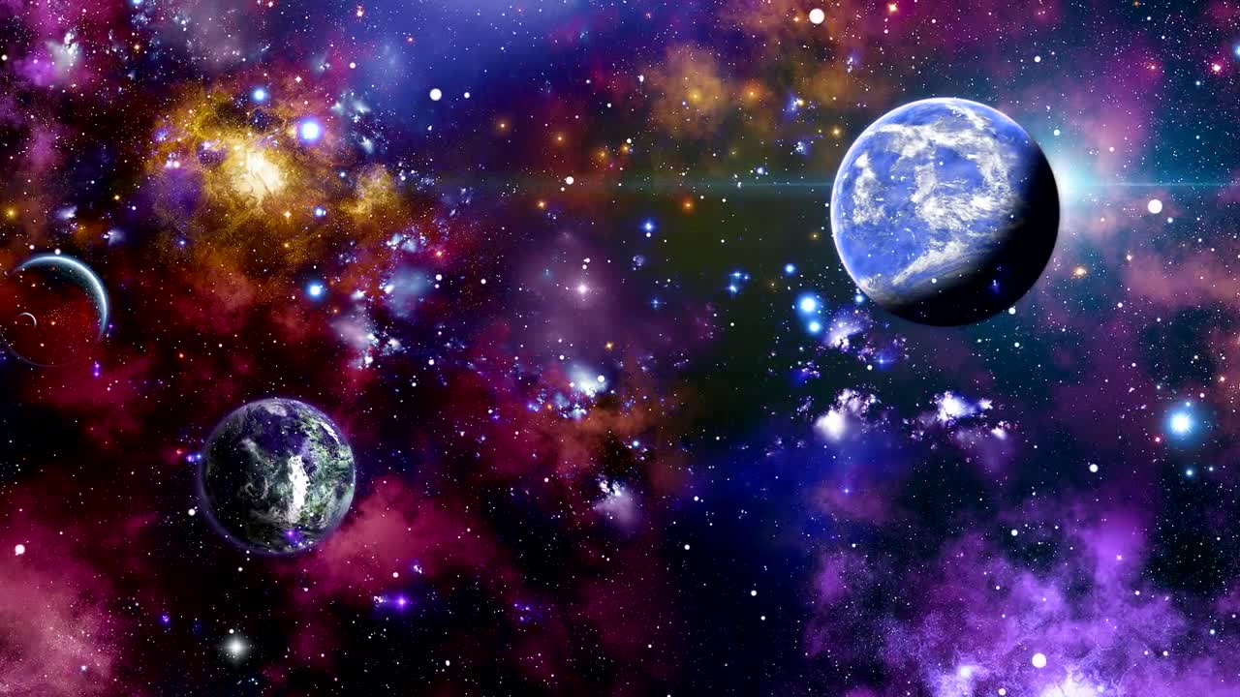
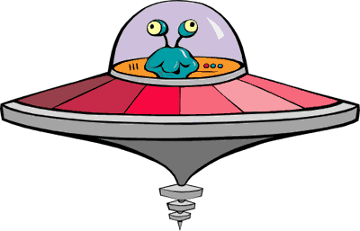
PE at MCA
Chapter 12 : Stones in the Lake
“ Then shortly before Christmas, Tammy and I saw Iggy down by the jetty, and he had brought a chicken with him. Like a live one.
Tammy had declared that it was the annual final of Stones in the Lake. (Best of five games, loser buys the winner a muffin from the school tuck shop.) It was two games each and it was all down to my last throw. I drew my arm back, determined to win this one, and as I threw with all my strength, I heard the shout, “SUZY !” and it put me right off. I knew before my stone hit the water that I had lost …”

Slide 2
COMPETITION TASK !!
Zero Gravity PE
You have just landed on an alien planet with 7 friends. You have plenty of food and water, and have been provided with shelter too. You have been there for 3 days and after exploring the area, you and your friends are getting bored. Luckily, someone brought a ball! The only problem is, the gravity on this planet is much weaker than Earth’s gravitational pull.
Challenge! Invent a game you can play with your friends on the alien planet. Think about how the ball will behave in the weaker gravity. You can use a balloon to help you imagine how the ball will move when thrown, hit or kicked.
Task 1 - Write a sheet of rules including how to score and win the game.
Task 2 - Write a list of any equipment you may need to find/make (nets, racquets etc)
Task 3 - Draw what the pitch/court looks like.
Higher challenge: Record your friends/family playing the game with a balloon. Maybe you can umpire or referee the game?
s
CLICK HERE TO UPLOAD YOUR WORK TO THE PORTAL TO WIN A FREE BREAKFAST AND ENTER THE PRIZE DRAW !!

