Slide 1
1.3 Secondary Storage
GCSE Computer Science

Slide 2
Section 1
Secondary Storage

Slide 3
Big Picture
What do you store on your phones? On your computers? Tablets?
Why do we need storage devices?
What could computers do without storage devices?

Slide 4
Secondary Storage Devices
Introduction
In everyday computer use, we need a way to write data, rewrite data, store data when the computer is switched off and retrieve data the next time we switch our computer back on.
We have already looked at system/primary memory:
RAM allows us to write data and store it…but the data is lost when it is switched off (volatile).
ROM allows us to store data when it has no power (non-volatile)…but we cannot write to it.
We therefore need another device/medium by which we can re-write data when we want AND store the data when the computer has no power.
This is where SECONDARY STORAGE comes in!

Slide 5
Learning Intentions
Identify the need for and purpose of secondary storage
Identify common types of storage
Match storage devices to their type of storage
Explain the characteristics of common types of storage
Keywords
Solid State
Optical
Secondary storage
Magnetic
Speed

Slide 6
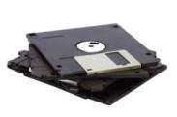
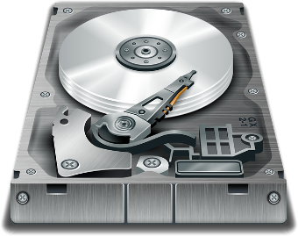
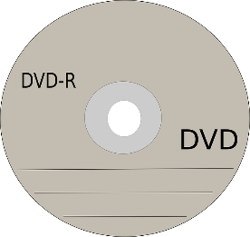
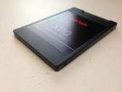
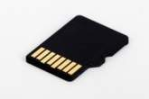
Storage Technologies
Magnetic Storage
Optical Storage
Solid State Storage

Slide 7
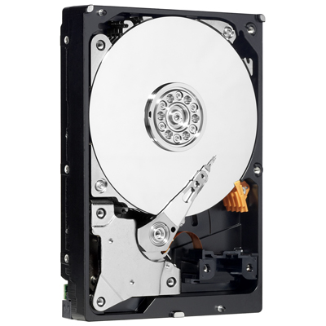
Magnetic Storage (HDD)
Magnetic storage uses special disks which are held inside a protective case.
There could be more than one disk inside the case.
Each disk is known as a platter.
Data is saved using a small magnetic charge.
A read/write read passes over the platter either setting a magnetic charge or removing it.
When reading it will detect is a charge exists or not.
The presence of a charge allows the reader to differentiate the difference between a 1 or a 0.

Slide 8
The video below shows how reading a HDD works

Slide 9
Magnetic Storage (HDD)
Magnetic Hard Disk:
Currently the most common type of secondary storage with very large capacities and good access speed.
The magnetic hard disk :
is reliable;
has a high capacity at low cost;
can be an internal device or external portable device for backup or transfer of large amounts of data;
stores the operating system, user data and programs.

Slide 10
Optical Disk
Optical disk:
CD (compact disk) or DVD (digital versatile disk)
can be read only or read / write
CD/DVD ROM used to distribute programs
CD/DVD R/W used to store, transfer or backup data and programs
high capacity at low cost
small and easy to distribute
robust and can be used many times
CD 700MB, DVD 4.7GB typical capacity
slower than other media such as hard disk and flash ROM

Slide 11
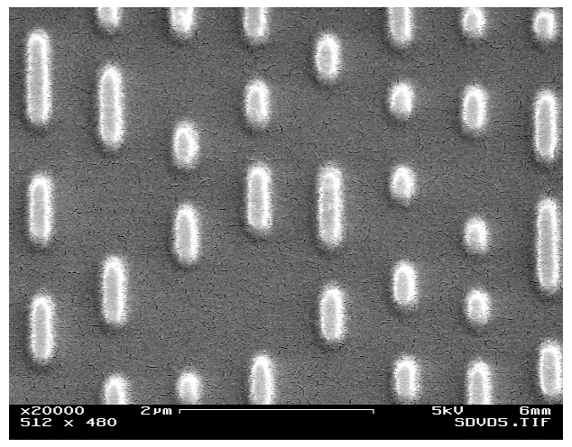
How Optical Storage Works
Optical storage devices will use lasers to store / read data from a disc.
Optical medium tends to be used for multimedia data and to allow games / software to be installed.
The image to the left shows what the surface of a CD looks like under a microscope.
It has a series of holes and spaces.
The white blobs are little holes in the surface!
A laser will travel over the surface of the CD.
If it hits a space it will reflect into a reader.
If it hits a hole it will “diffuse” and err not hit the reader!
This effectively allows us to store 1 or 0!

Slide 12
The Video Below show Reading CD works

Slide 13
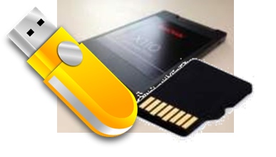
Storage Technologies
Solid State Storage (Flash)
They work by sending a large electric current to force electrons through a barrier and trapping them in position.
The flash of the electric current used to achieve this gives us the name for this type of memory.
The different arrangement of electrons gives us data.
Arrangement of electrons read by computer
Electrons forced through barrier
E
E
E
E
E
E
E
E
Flash of Electric Current

Slide 14
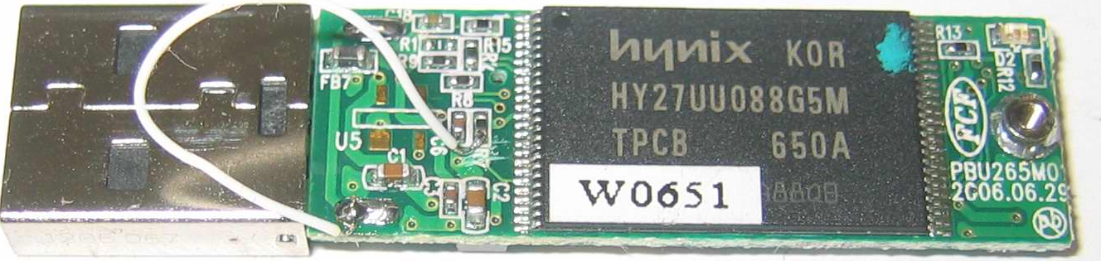
Flash (Solid State ) Memory
Electronically changeable Read Only Memory
Used in portable devices such as cameras, MP3 players, tablet computers and mobile phones
Used with a USB interface as a backup / transfer medium for personal files
Fast Read/Write access times
Reliable with no moving parts to go wrong
Low power use
Small, light, robust and highly portable
Inexpensive at relatively low capacities but expensive at higher capacities.

Slide 15
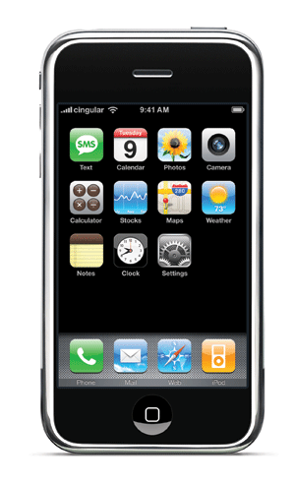
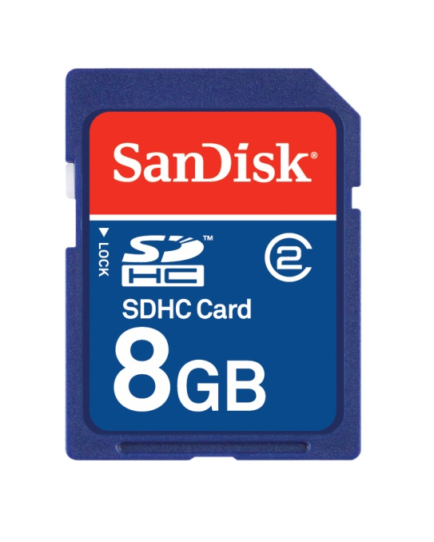
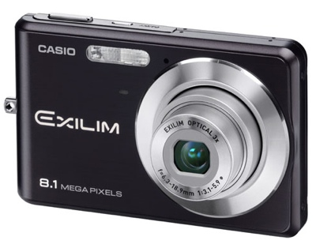
Solid State in Devices
Solid state memory is found in devices such as the
Ipod nano, Iphone, mobiles in general, SD cards and other types of memory card.
Internal memory in cameras also use solid state.

Slide 16
Activity
20 minutes
Open “Secondary Storage Booklet ” in your area
Complete all activities in
Section 1 Need for Secondary Storage

Slide 17
Section 2
Types of Secondary

Slide 18
Learning Intentions
Be able to recommend a storage device for a situation
Estimate data capacity requirements for different file types
Keywords
Reliability
Capacity
Portability
Speed
Durability

Slide 19
Characteristics of Storage Devices
Capacity
how much data can it store?
Speed
how fast can it access the data?
Portability
how easy is it to move it from one place to another
Durability
how well does it last e.g. if it is dropped
Reliability
how consistently does it perform
Cost
how much does it cost per KB, MB or GB?

Slide 20
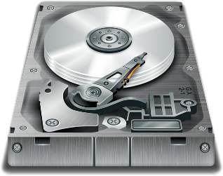
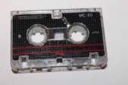
Which storage media, when and why?
Magnetic Storage
Use | Desktop computers to store large files, programs and operating systems
Capacity | 750GB – 3TB (3000GB) (Large)
Speed | High read/write speeds
Portability | Heavy / poor portability (even external are clunky!)
Durability | Dropping this device could cause damage, especially to the ‘read head’
Reliability | Can be used again and again but does have a limited life (a good few years)
Cost | Low cost (quite cheap)
Hard Disk
(Hard Drive)
Use | Backing up vast amount of data
Capacity | 1 – 5TB (Very Large)
Speed | High write speeds BUT Slow read speeds
Portability | Fairly small and light (but reading device is not because if the data you need is at the end of the tape you have to read/play the tape from the start – which takes time (known as serial access))
Durability | Fairly durable.
Reliability | Can be used again and again.
Cost | Cheap
Magnetic
Tape

Slide 21
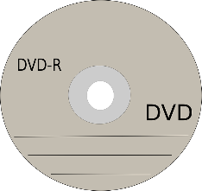
Which storage media, when and why?
Optical Storage
Use | Storage of small media files and documents
Capacity | 650MB (Small)
Speed | Moderate read/write speeds
Portability | Very portable and light
Durability | Fair durability, can survive the odd knock but scratches can damage the data.
Reliability | CD-Rs are write once but can be read over and over. (CD-RW can be reused)
Cost | Very cheap
CD-ROM
BLU-RAY
Use | Storage of larger media files and documents
Capacity | 4.37GB (DVD) 25GB (Standard Blu-Ray) (Small)
Speed | Moderate read/write speeds
Portability | Very portable and light
Durability | Fair durability, can survive the odd knock but scratches can damage the data.
Reliability | DVD-Rs are write once but can be read over and over.
Cost | Very cheap
DVD-ROM

Slide 22
Which storage media, when and why?
Solid State / Flash Storage
Use | Desktop computers, laptops and tablets to store large files, programs and operating systems
Capacity | 64GB – 480GB (Moderate)
Speed | Super Fast (Read/Write)
Portability | Very portable (small and lightweight)
Durability | No moving parts so can survive knocks and scrapes
Reliability | Can be re-used many times (up to 100,00 times)
Cost | Very Expensive (per Gb)
Solid State
Drive
Use | Phones, Cameras (portable devices) – great choice as no moving parts so mobile devices can function whilst on the move
Capacity | 16GB – 64GB
Speed | Super Fast (Read/Write)
Portability | Extremely portable (small and lightweight)
Durability | No moving parts so can survive knocks and scrapes
Reliability | Can be re-used many times (up to 100,00 times)
Cost | Expensive (per Gb)
Flash
SD Card

Slide 23
Which storage media, when and why?
Solid State / Flash Storage
Use | Backing up or transferring documents, small media files from computer to computer
Capacity | 1GB – 64GB
Speed | Super Fast (Read/Write)
Portability | Extremely portable (small and lightweight)
Durability | No moving parts so can survive knocks and scrapes
Reliability | Can be re-used many times (up to 100,00 times)
Cost | Expensive (per Gb)
Flash Memory Stick

Slide 24
Other Storage Methods
Network Attached Storage (NAS)
Use | A stand alone external hard drive at the centre of a network. Plugs into the network to allow users of different computers to write or read files. Usually documents and media files.
Capacity | 750GB – 3TB (3000GB) (Large)
Speed | Hard disk has high read/write speeds The network speed (transfer of data from computer to NAS) can cause slow data access speeds
Portability | Heavy / poor portability.
Durability | Dropping this device could cause damage, especially to the ‘read head’
Reliability | Can be used again and again but does have a limited life (a good few years)
Cost | If Hard Disk is used then storage is cheap If SS Disk is used then storage is expensive In addition to the storage, the NAS enclosure can be very expensive depending on its features.
NAS Drive

Slide 25
Other Storage Methods
Cloud Storage (online storage)
Use | Used to store documents and media files online. This means that you can go to another computer and access your files (providing you have internet access)
Capacity | Unlimited (providing you can pay for it).
Speed | Depends on network / bandwidth speeds Poor bandwidth can cause uploading and downloading of large files to take a long time
Portability | It is virtual so you don’t have anything physical to move around.
Durability Reliability | Providing you keep up payments and the company looks after their storage devices – very durable and reliable. This is often because they back up storage devices in many places. There can be issues with the law as a company’s data may be stored in a country which doesn’t follow the same data protection laws. The hosting company could also me attached by hackers who could steal your data.
Cost | Can be expensive depending on the service – but often it is free for a few Gbs.

Slide 26
Scenario 1
A graphics designer needs to store their creations (images, sound and video).
They work mainly from home, but like to take their work to events and meetings.
What characteristics do they need from the storage device?
Large capacity
Portability
Durability
Reliability
What do you recommend? Why?

Slide 27
Scenario 2
The Managing Director of a small accountancy firm stores data about the company’s clients and their accounts.
The Managing Director only works at the office.
What characteristics do they need from the storage device?
Small capacity
Reliability
Fast access
What do you recommend? Why?

Slide 28
Activity
20 minutes
Open “Secondary Storage Booklet ” in your area
Complete all activities in
Section 2: Example of Secondary Storage .

Slide 29
Activity
Open “4-Storage Device Justification” form the Secondary Storage folder
For each of the scenarios on the worksheet:
Identify the most appropriate type of storage
Justify (explain) your choice

Slide 30
Storage Device Justification– Answers
Scenario | Type of Storage | Justification
A student needs to bring their homework into school | Solid state | e.g. Portable – for carrying to and from school Durable – can be knocked around in bags and not break Fairly reliable – unlikely to get scratch like optical
A media student needs to store a video they have made to distribute to their friends | Optical/Solid state | e.g. (for optical) Capacity - Only 1 video needs saving and this will be sufficient Portability – can be transported, so given to other people Durability – is poor, but it does not need to be moved a lot, only once to another person Cost – this is low and as the device is to be given away this is more beneficial
A software developer has created a trial version of their software that will be given away in magazine | Optical | Cost – to be given away, so low cost needed Portability – small enough to be put in magazine, can be moved Durability – will need protecting in magazine Capacity – sufficient for software
A school needs to back-up its data every evening | Magnetic | e.g. (for magnetic) Tape Drive or Large HDDs Capacity – large so can hold all types of data Speed – relatively fast, so backup will not take a long time Portability – does not need to be moved Reliability – fairly reliable type so backup is unlikely to be lost Cost – low per GB

Slide 31
Storage Device Justification– Answers
Scenario | Type of Storage | Justification
A large corporation needs to store data about its customers, stock and orders | Magnetic/SS | e.g. (for magnetic) Capacity – large so can hold all the data Speed – relatively fast, so data can be found and retrieved quickly Portability – does not need to be moved Reliability – fairly reliable to data will not be lost Cost – low per GB and a large capacity will be needed
A web server needs to store a multimedia website for web-users to access | Magnetic/SS | e.g. (for magnetic) Capacity – large so can hold range of multimedia Speed – relatively fast, so server requests will be within a reasonable time Portability – does not need to be moved Reliability – fairly reliable type so ca be accessed many times Cost – low per GB

Slide 32
Activity 3
Sam is a music student.
He needs to take his files from home to the school.
Identify a method of storage which is suitable for taking his music files into school.
Explain why this method is suitable (7 marks)
How are we going to answer this question?

Slide 33
Activity 3
Analysing the question
Sam is a music student.
He needs to take his files from home to the school.
Identify a method of storage which is suitable for taking his music files into school.
Explain why this method is suitable (7 marks)
How are we going to answer this question?

Slide 34
Activity 4
Peer Assessment Task
Identifying a suitable device = 1 mark
Discussing any three of the following:
Portability (1 mark) and saying why this is suitable for Sam (1 mark)
Capacity (1 mark) and saying why this capacity is suitable for Sam (1 mark)
Reliability (1 mark) and saying why this is suitable for Sam (1 mark)
Durability (1 mark) and saying why this is suitable for Sam (1 mark)
Speed (1 mark) and saying why this is suitable for Sam (1 mark)

Slide 35
Data capacity
In group discuss the size of each of these units of storage and put them in order from lowest to highest:
GB
KB
Byte
MB
TB
Nibble
Bit

Slide 36
Data capacity
Traditionally 1 KB = 1,024 bytes
In exams, we can use 1KB = 1,000 bytes
This makes the maths easier!
You will be expected to be able to calculate file sizes and storage space needs
The following are examples of what you may be asked to do

Slide 37
Sizes of Text files
1 byte per character, + 10% for any overheads (e.g. file type)
A text file with 1000 characters will have approximately?
1000 bytes * 1.1 = 1100bytes
How many KB?
1100/1000 = 1.07 KB

Slide 38
Database
Data Type | No. Bytes
Text | 1 byte per character
Integer | 4/8 bytes
Real | 4/8 bytes
Boolean | 1 byte
Date | 8 bytes
e.g. a database record has 4 fields:
FirstName (text up to 10 characters)
Surname (text up to 10 characters)
DateOfBirth
NumberOfChildren
The database will need to store 100 records.
Step 1: How many bytes in 1 record.
FirstName = 10 bytes, Surname = 10 bytes, DateOfBirth = 8 bytes, NumberOfChildren = 4 bytes.
Total = 32 bytes
Step 2: Multiply by the number of records
32 * 100 = 3200 bytes
Step 3: Add 10% for overheads
3200 * 1.1 = 3520 bytes or 3.52 KB

Slide 39
Image
(Number of pixels * number of bytes per pixel) + 10% for overheads
E.g. an image is 1024 x 720 pixels. It has 256 different colours.
256 colours = 8 bits per pixel (1 byte), because with 8 bits you can have 256 different combinations
Number of pixels = 1024 * 720 = 737280 pixels
737280 * 1.1 = 811008 bytes or ...
...811008/1024 = 792KB

Slide 40
Sound
bytesPerSample * samplesPerSecond * channels * duration
E.g. a sound file has 2 bytes per sample, it takes 10 samples per second, over 2 channels and is 30 seconds long.
2 * 10 * 2 * 30 = 1200 bytes or...
..1200/1024 = 1.17 KB

Slide 41
Activity
20 minutes
Open “Secondary Storage Booklet ” in your area
Complete all activities in
Section 5: Calculating File Size.

Slide 42
Activity 2 - Answers
10000 * 1 * 1.1 = 11000bytes = 10.7 KB
(6+20+15+8+4+4) * 200 * 1.1 = 57 * 200 * 1.1 = 12540 bytes = 12.24 KB
2030 * 1000 * 2 * 1.1 = 4466000bytes = 4361.3 KB = 4.3 MB
4 * 100 * 1 * (2 * 60 + 30) = 400 * (150) = 60000bytes = 58.6KB

Slide 43
Plenary
Working in mixed pairs, put these files into order from smallest to largest:
A text file with 220 words
An image that is 1000 x 200 pixels, with 1 byte per pixel
A sound file that has 1 byte per sample, it takes 2 samples per second, over 1 channel and is 600 seconds long
An image that is 100 x 200 pixels, with 2 bytes per pixel
A text file with 3000 words

Slide 44
Plenary Answer
A text file with 220 words (220*1.1 = 242 bytes)
A sound file that has 1 byte per sample, it takes 2 samples per second, over 1 channel and is 600 seconds long (1*2*1*600 = 1200 bytes)
A text file with 30000 words (30000 * 1.1 = 33000 bytes)
An image that is 100 x 200 pixels, with 2 bytes per pixel (100*200*2*1.1 = 44000 bytes)
An image that is 1000 x 200 pixels, with 1 byte per pixel (1000*200*1*1.1) = 220000 bytes

