Slide 1
1.7 System Software
GCSE Computer Science

Slide 2
Section 1
Operating System

Slide 3
Learning Intentions
Be able to understand the key ideas of the operating system
Be able to understands the functions of the Operating System
Keywords
Multitasking
Command Line Interface
Graphical Unser Interface
Speed
Device Driver

Slide 4
Software Category
Software
System Software
Application Software
Operating System
Utility Software
Security
Disk Organisation
Maintenance
Anti Virus
Anti Spyware
Firewall
Disk Formatting
File Transfer
Defragmentation
System Update
System Clean Up
System Diagnostic
MS Word
GarageBand
Photoshop
Window Movie Maker

Slide 5
The operating system
Apple
Windows
Linux
There is more than one operating system (or OS).
The three main types are Apple, Linux and windows.
Most people use Windows but Apple and Linux also have a large number of users.
There are some major differences between the three different types and it is important to know the advantages and disadvantages of each.

Slide 6
Functions of the OS
Apple
Linux
Windows
A Operating System (OS) is known as system software. It is responsible for;
Managing all connected devices (like keyboards)
Managing Memory (RAM and Virtual Memory)
Managing running programs
Managing the file system
Managing security
Managing network and internet connections

Slide 7
OS split into sections
The operating system is split into the following sections.
The desktop offers a graphical interface to hide the details of what the OS is REALLY doing!
OS interface (desktop)
RAM
Memory manager
Process
manager
File
manager
Device drivers
Add this to your Note
Hardware

Slide 8
WIMP!
OS offer a interface for the user to use.
This allows the user to run other software such as a word processor, a game or a file browser.
They offer a GUI interface which uses WIMP.
Or a graphical user interface which offers windows, icons, menus and pointers!
The interface then uses human interface devices (like a mouse) to allow manipulation of the OS.

Slide 9
Windows!
Do not confuse a “window” with “windows” the OS!
Each application will open up in a new window.
This can be dragged, resized or closed by the user.
The image to the right shows two windows open with different applications running.
The user interface of the OS controls these windows.
It will send messages to the applications to inform them of things such as keyboard presses or mouse clicks.
In the world of programming these are known as events!
It is why when you hit a key the letter appears in the right window.
The OS is controlling where the message gets sent to!

Slide 10
Icons
Icons are small images which represent a action or task within a application or OS.
When the user clicks on a icon an event is sent to the application so it can deal with that event.

Slide 11
Menus
Menu’s are used to access features which may not be as well used as the ones represented by icons.
A menu is split into sections (such as File, Edit, View etc) which can be further split up.
The OS handles the drawing of the menu while the application handles the contents and the action associated with the menu item.

Slide 12
Memory Management
Photoshop
Word
OS
Excel
Memory is shared amongst all of the programs running on your system.
The diagram above shows how memory may be split up.
The OS has the responsibility to manage which program has what part of memory.
This is known as memory management.
The memory manager is a small piece of code within the OS which will –
Allocate memory to a program
Will reclaim it when it is not in use
Will swap memory blocks in and out of virtual memory
Will prevent programs from accessing each others memory.

Slide 13
Preventing Hacking
The memory manager must stop a program from accessing other parts of memory.
Spyware
Photoshop
Word
OS
Web browser
Consider spyware running on a system.
If it could have access to the web browser memory it could read all of your sensitive information.
It could also over write it and even control your web browser!

Slide 14
Allocating Memory
When a program needs memory it must ask the memory manger to allocate it.
The memory manager will need to decide if anything will need virtual memory or not.
Web browser
Word processor
Memory manager
Photoshop
Word
Word
OS
Web browser

Slide 15
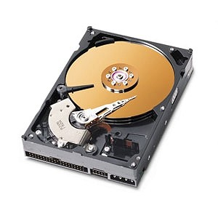
Allocating Memory and Virtual Memory
Web browser
Word processor
Memory manager
Photoshop
Word
Word
OS
Web browser
Word

Slide 16
Greedy program
Sometimes a program may use up more memory than it should.
The OS should prevent a single program from accessing ALL of the memory as this would prevent other processes from running.
Web browser
Word processor
Memory manager
Word
Word
Word
OS
Web browser
Word

Slide 17
Memory and Task Manager!
You can monitor how much memory is being used on your computer.
Each running program will say how much memory has been allocated to it.
The image to the right shows that a program called “iexplore.exe” is using 160Mb of RAM.
If your system is always running slow it may be worth looking to see what memory is being used and see if there is a memory hog!

Slide 18
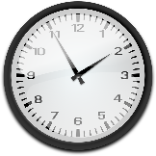
Activity
15 minutes
Open “Software Booklet ” in your area
Complete all activities in
Read the information provided
Section 1: Operating System .

Slide 19
Multi-tasking
Multi-tasking is how the OS can run more than one program at once.
It gives the illusion that programs are running concurrently while in reality they are simply taking turns on the CPU.
EACH CORE CAN ONLY RUN ONE PROGRAM AT A TIME!!!!

Slide 20
Illusion of Concurrency
EACH CORE CAN ONLY RUN ONE PROGRAM AT A TIME!!!!
So how does the OS allow us to have as many programs running at the same time?
The OS will run one program at a time but swap them around so each program has a chance to run.
It does this so fast that the user is not aware that it is happening.
Multi-tasking is the term we use to explain the idea that a CPU can run many programs at once by quickly swapping them about.

Slide 21
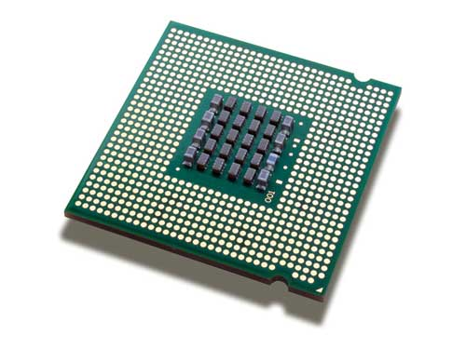
How Multi-tasking works
Word
processor
Web browser
running
Waiting
The CPU will be running a program in the normal way.
Another program will be waiting for access to the CPU.

Slide 22
How Multi-tasking works
Word
processor
Web browser
running
Waiting
After a while (a few milliseconds) the running program is “swapped” out and placed in the waiting queue.

Slide 23
How Multi-tasking Works
Web browser
Word
processor
running
Waiting
The new program will then get a chance to run by swapping it into the running state.

Slide 24
How Multi-tasking Works
Web browser
Word
processor
running
Waiting
This continues until the programs are closed.

Slide 25
How Multi-tasking Works
Word
processor
Web browser
running
Waiting
This continues until the programs are closed.

Slide 26
How Multi-tasking Works
Web browser
Word
processor
running
Waiting
This continues until the programs are closed.

Slide 27
How Multi-tasking Works
Word
processor
Web browser
running
Waiting
This continues until the programs are closed.

Slide 28
How Multi-tasking Works
Web browser
Word
processor
running
Waiting
This continues until the programs are closed.

Slide 29
How Multi-tasking Works
Word
processor
Web browser
running
Waiting
This continues until the programs are closed.

Slide 30
Activity
15 minutes
Open “Software Booklet ” in your area
Complete all activities in
Read the information provided
Section 1: Operating System .

Slide 31
Issues with multitasking
The following are the disadvantages of Multi-tasking;
Swapping programs around takes time.
If it is done too often then the system will slow down as too much time will be spent doing the swap!
If programs are not swapped often enough then the user will notice “freezes” where the screen stops responding.
This is when the running program is waiting for CPU time or another device such as the hard drive.
Multi-tasking also makes programming harder as it can cause bugs which are unpredictable!

Slide 32
Peripheral management
Peripheral device – A device plugged externally into the PC to provide additional function
Many different devices can be plugged into a PC.
These will perform input, output and storage functions and are made by many different vendors.
The OS needs to be able to communicate and manage all of these devices! No easy feat!
In order to communicate with hardware the OS will use device drivers.
These are small programs written by the vendor to allow the OS a generic way of communicating with the hardware.

Slide 33
Device Drivers
The device driver converts what the OS wants to do into messages that the devices understand.
Consider different printers....
OS interface (desktop)
Memory manager
Process
manager
File
manager
Device drivers
Hardware

Slide 34
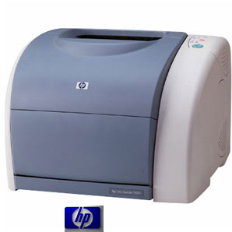
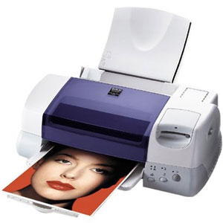
Device Drivers
When the user clicks print they expect it to, print ☺
The OS will use the device driver of the printer the user selected.
This will then translate the print request into something the printer will understand.
This then gets sent to the printer by the device driver.
The printers will then dutifully print!
Device drivers
Hardware

Slide 35
Peripheral management
Peripheral device – A device plugged externally into the PC to provide additional function
As well as communicating with the device the OS needs to be able to register the device so it can be recognised by other programs.
It also needs to deal with the fact that they can be unplugged.
This “registration” will link the device with a device driver.
You can see this by going to “device settings” or “device manager”.
Or you can type in lspci or lsusb under Linux!

Slide 36
Device Manager – Windows 7

Slide 37
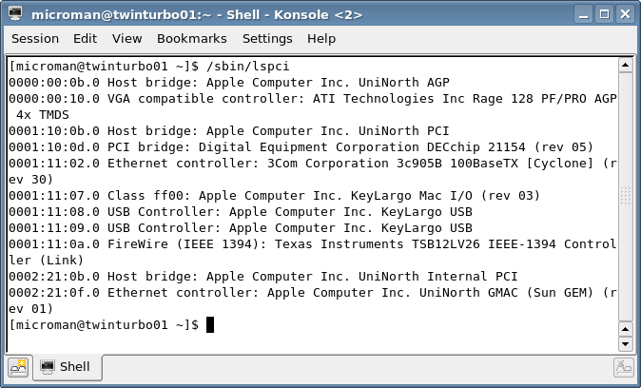
Device manager – Linux

Slide 38
Activity
15 minutes
Open “Software Booklet ” in your area
Complete all activities in
Read the information provided
Section 1: Operating System .

Slide 39
Section 1
Utility Software

Slide 40
Learning Intentions
Understand what is meant Application Software
Understand what is meant by utility software
Understand how common utilities works
Security
Disk organisation
Maintenance
Keywords
Maintenance
Fragmentation
Utility
Compression
Security
Encryption
Anti-Virus

Slide 41
Software Category
Software
System Software
Application Software
Operating System
Utility Software
Security
Disk Organisation
Maintenance
Anti Virus
Anti Spyware
Firewall
Disk Formatting
File Transfer
Defragmentation
System Update
System Clean Up
System Diagnostic
MS Word
GarageBand
Photoshop
Window Movie Maker

Slide 42
Application Software
Application software can be used outright to perform a specific task.
For example
produce a letter,
chat to a friend or
create a movie.
A application can be found on any computing device.
The term app (short for application) has been made popular by Apple’s app store.
This allows iPhone users the chance to download new applications for their mobile devices.

Slide 43
Utility Software
Utility software on their own will not help the user perform any meaningful task.
They are there to support application software perform their tasks.
For example Anti-virus software is a security utility.
On it’s own it is not very useful.
However when combined with a web browser it becomes essential to protect the end user from viruses.
Utility software helps maintain the computer system.
They tend to run in the background or be used by applications in order to get tasks done.
The operating system will use them to keep the system healthy.
They can also be used directly by the user should the need arise.

Slide 44
Types Utilities
There are three main areas of Utilities
Security Utilities
Anti-Virus
Anti-Spyware
Firewall
Encryption
Disk Organisation Utilities
Disk Formatting
Defragmentation
Compression
Maintenance Utilities
System update
System clean up
System diagnostics

Slide 45
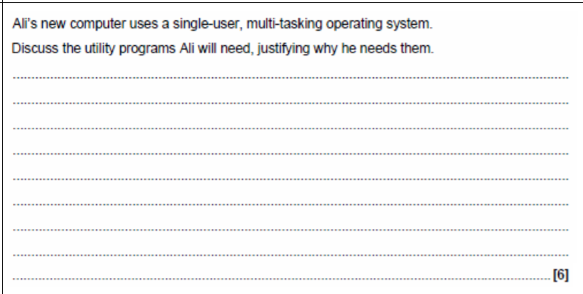
Exam Question

Slide 46
Anti-Virus
Anti-virus software will scan through your system looking for infected files.
A infected file will contain a virus which could cause damage to the PC.
The virus scan works by looking at every file in your system. It looks for patterns in each file which could suggest a virus.
It will compare each file against a large database of known viruses.
If a virus is found then the file is moved into a safe area known as a quarantine zone.
The virus can no longer cause a threat to the system and can be deleted.
The user may wish to salvage part of the infected file or just delete it.
Viruses can be attached to almost any file.

Slide 47
Anti-spyware
Anti-spyware software works the same as anti-virus.
Spyware can be benign (pop adverts) or malicious (record key strokes).
Spyware tends to use the internet in order to download adverts or upload user behaviour.
As such you can detect spyware by monitoring your network traffic.
Good anti-spyware and firewall software will do this automatically for you.

Slide 48
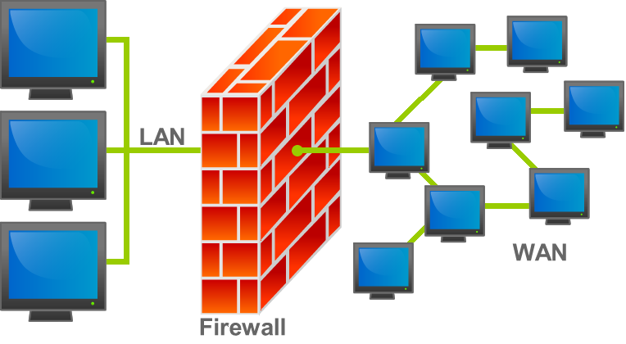
Firewall
A firewall will sit in between your PC and the internet.
It will monitor all incoming and outgoing network traffic and only allow traffic which has been enabled by the user.
It stop unauthorised access to your computer
By default applications do not have access to the internet unless the user allows them.

Slide 49
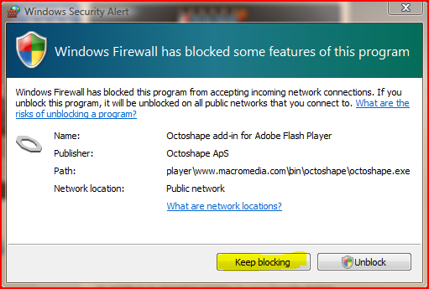
Firewall
Below is a example of the message used in windows.
If you click on “keep blocking” then the application will not be able to use your internet connection.
It is always worth reading this dialog as it can prevent unwanted applications using your connection.

Slide 50
Firewalls and ports
To allow multitasking for applications using the internet each one will use a different port.
A port is a number which is given to each application to allow them to control what data goes to what application.
For example web browsers uses port 80 while FTP uses port 21.
Games will use random port numbers (5583 for example).
A firewall can easily block these ports up to prevent all access.

Slide 51
What is encryption?
It’s a way of getting a message from one person to another person without anyone else being able to understand it.
Encrypted data can only be decrypted with the correct decryption key.
Encryption is widely used to protect information. It is an area of computing and mathematics called Cryptography.
It scrambles data into a form that cannot be understood by the wrong people.

Slide 52
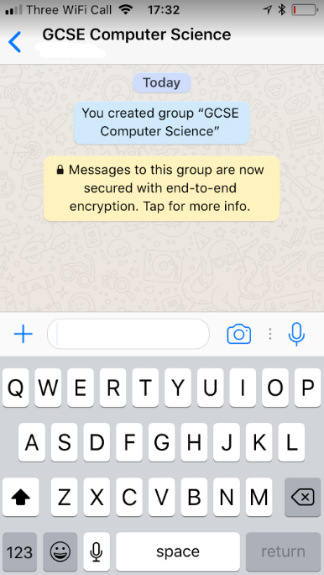
Who uses it?
Encryption usage is increasing
Consider who uses encryption?
You do!
Messaging Apps
Social Media Sites

Slide 53
Who uses it?
Encryption on Web Pages
HTTPS Web Pages use encryption. Look for the ‘Padlock Icon’ below

Slide 54
Who pioneered using encryption and why?
Hiding Information is nothing new.
In the 1st Century BC…
When Julius Caesar sent messages to his general, he didn’t trust his messengers. So he replaced every A in his messages with a D, every B with an E, and so on through the alphabet
Julius Caesar used a system of shifting the alphabet three spaces to the left to hide messages.
We call this a Caesar Shift Cipher.
Julius Caesar

Slide 55
Why use it?
To keep your data safe and private
Increasingly hackers, thieves, companies, and other organisations are eavesdropping and snooping on our data.
What was once thought to be private can increasingly fall into the hands of the wrong people.

Slide 56
How Encryption Works - Keys
02
The ‘private’ key is used by the sender of information. The private key is just that, private. It is typically stored on a device and never leaves it.
01
To successfully encrypt data one method is to use ‘public’ and ‘private’ keys.
03
The ‘public’ key is used to communicate with the sender.

Slide 57
How Decryption Works - Keys
To successfully decrypt data you need the correct ‘private key’.
SUCCESS
Incorrect key
Incorrect key
Incorrect key

Slide 58
Activity
15 minutes
Open “Software Booklet ” in your area
Complete all activities in
Read the information provided
Section 2: Utilities Software.

Slide 59
Disk Organisation
Disk organisation refers primarily to the hard drive (or primary storage) but it does also include secondary storage devices.
The main utilities are –
Disk formatting
Defragmentation
Compression
File transfer / maintenance

Slide 60
Disk Formatting
Formatting a hard drive will delete all files on that disk. Yes all files!
It is much more common on secondary storage rather than primary storage.
The only time it would be used on a hard drive was if you were doing a new install of a operating system.
When a disk is formatted it will perform a high level format.
This means that all sectors on the disk are made available.
This means data may be recovered using special software.
A high level format is also known as a quick format.
A low level format will overwrite areas of the disk.
This will destroy any previous data.
This will take a long time to perform on a hard drive (a few hours at least) so it is rarely used.
If you were going to sell a device you may decide to perform a low level format on it.

Slide 61
File Transfer
File transfer is another way of saying copying files. This may seem like a simple task but it is far from it!
For example when you copy a file from your hard drive to a memory stick you could be copying a file from a NTFS file system to a FAT32 file system. Both store files differently.
The file transfer utility will mask differences between file systems and devices.
It will normally have a graphical interface.
On windows it is called explorer (note the lack of the work internet. Internet explorer is NOT a utility and is separate) and Linux can use many different ones (thunar, dolphin, nautilus...).
As well as copying files it can move, delete and rename files.
It can not open files.
This is done by applications.

Slide 62
Activity
Research how to use the three file utilities.
Disk formatting
Defragmentation
File transfer / maintenance
Write down where you would find these tools on your home computer.
Add new slides in your software PowerPoint and make notes on your research
NOTE – DO NOT USE FORMAT. IT WILL DELETE FILES

Slide 63
Maintenance Utilities
Maintenance utilities will help keep your computer safe and secure.
They will provide detailed feedback on how the computer is running in the form of diagnostics.
The main three types are –
System update
System clean up
System diagnostics
Note – Diagnostics will contain a lot of detailed technical data. You are not expected to understand all of it.

Slide 64
System Clean Up
Over time there will be a lot of left over files which are no longer needed.
These take up space on your hard drive and could potentially slow your computer down.
System clean up utilities will look through your computer for these files and automatically remove them.
These files include –
Cache files from browsing the internet
Left over files from updates / installing applications
Files left over when a program is removed
These files will appear over time so it is important to run this utility regularly.
Once a month would probably good enough unless you install and remove a lot of applications.

Slide 65
System Diagnostics
System diagnostics is a utility which will give you detailed information about the current state of your computer.
This will include –
What programs are running and how much CPU time they take up
Memory usage and how much memory is left over
Hard drive access
Network access
A lot of the information will be technical and it is designed for technicians to discover problems with a PC.
However novice users can also learn how to use it as it is a good way of finding problems before they become a big issue.

Slide 66
System Update
There will always be problems (or bugs) with your software.
These will arise over time and will be fixed by the software providers.
In order to get these fixes, or updates, you will need to run system update.
Commonly this is run in the background and the user will not need to do anything.
The utility software which does this will check the version of your software.
It will then compare it to the software on a update server.
If your version is older then it will download the newer version. This process will require an internet connection.
You can run update manually or schedule it to occur at certain points.
Normally a check is done when you boot your PC up as then the updates can be downloaded in the background while you are working.
Sometimes updates will require a restart of the PC. If that is the case then the update utility will inform you.

Slide 67
Activity
Open your Software Power Point
Add new slides and call them Utilities and make details notes on the following;
What is Maintenance utilities
Describe System Update
Describe System Clean Up
Describe System Diagnostics
Make sure you do some research to help support your notes!

Slide 68
Homework
Open up resource monitor at home (or an equivalent piece of software).
Take a screen shot (crop it!) of the -
CPU graph
Disk graph
Memory graph
Now run a program which will take up a lot of resources. This can be –
A complete virus scan
A computer game
Ripping a CD to your hard drive
Take another screen shot of the three graphs. Explain why they are different.
Hint – [ALT] + [TAB] will allow you to flip between programs.

