Slide 1
YEAR 6 TRANSITION TASK : HISTORY
Chapter 20 : The Humans
I felt someone nudge me. “Come, “ said an older classmate Kallan,taking me by the hand. “Its time to see a ‘movie’.”
We followed some other visitors into a large, darkened room,with chairs and a screen at one end,showing a 2D moving picture.
“Behold!”said Mr Park. “You are about to witness one of the primary pastimes of the creatures on Earth. It is possibly this that most distinguishes these creatures from more advanced life forms such as us. They spend an astonishing amount of time reading about things that are not true, or watching them on a screen… This ‘movie’ or ‘film’ was collected during The Great Exploration. “

Slide 2
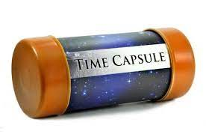
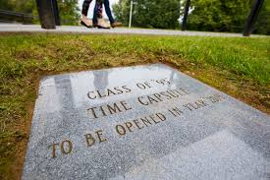
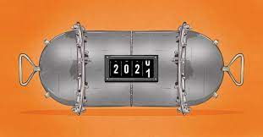
What’s a time capsule?

Slide 3
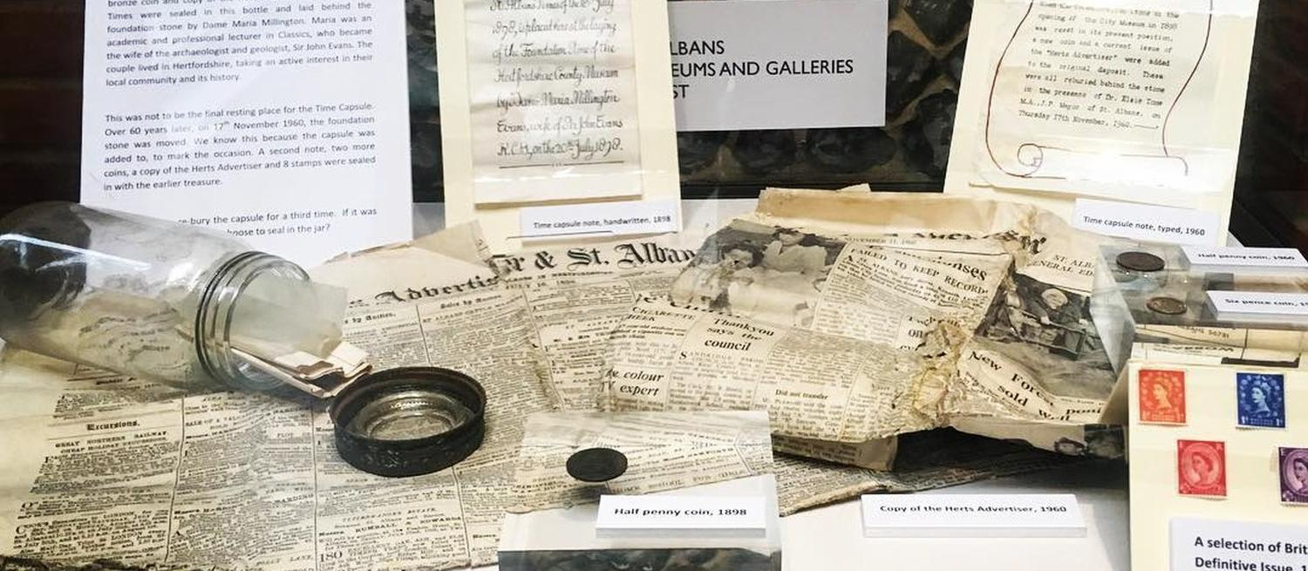
Time capsules are fascinating things that help to unlock the past and to help us understand what daily life was like for those that lived before us…follow the link below to find out what the Victorians left behind for a hospital in Enfield to discover!!
https://www.bbc.co.uk/programmes/p07b8l0n

Slide 4
At MCA, we love looking at the evidence that people have left behind-possibly because we are nosey- but also so we can pick up clues that help us to understand more about the past.
Over the next few slides, we are going to lay out some object that could be in a time capsule from another time in History. We want you to help us to work out what the objects are and what they might have been used for!

Slide 5
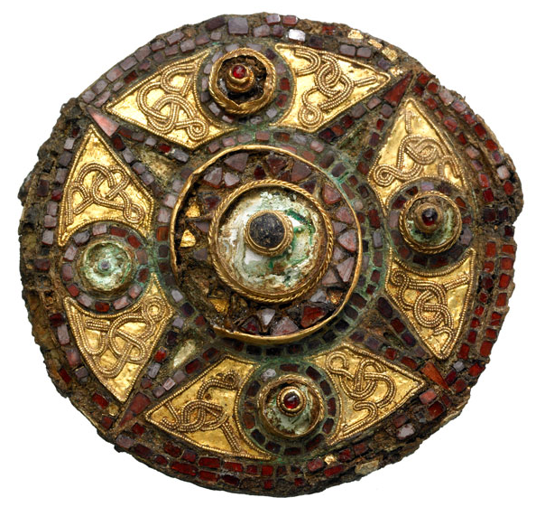
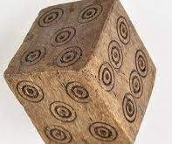
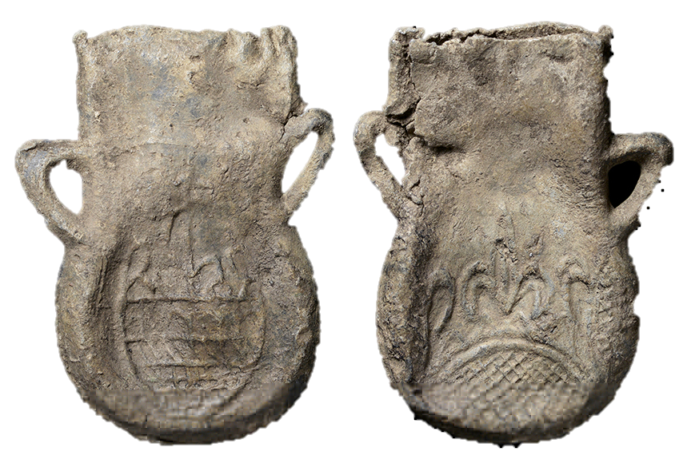
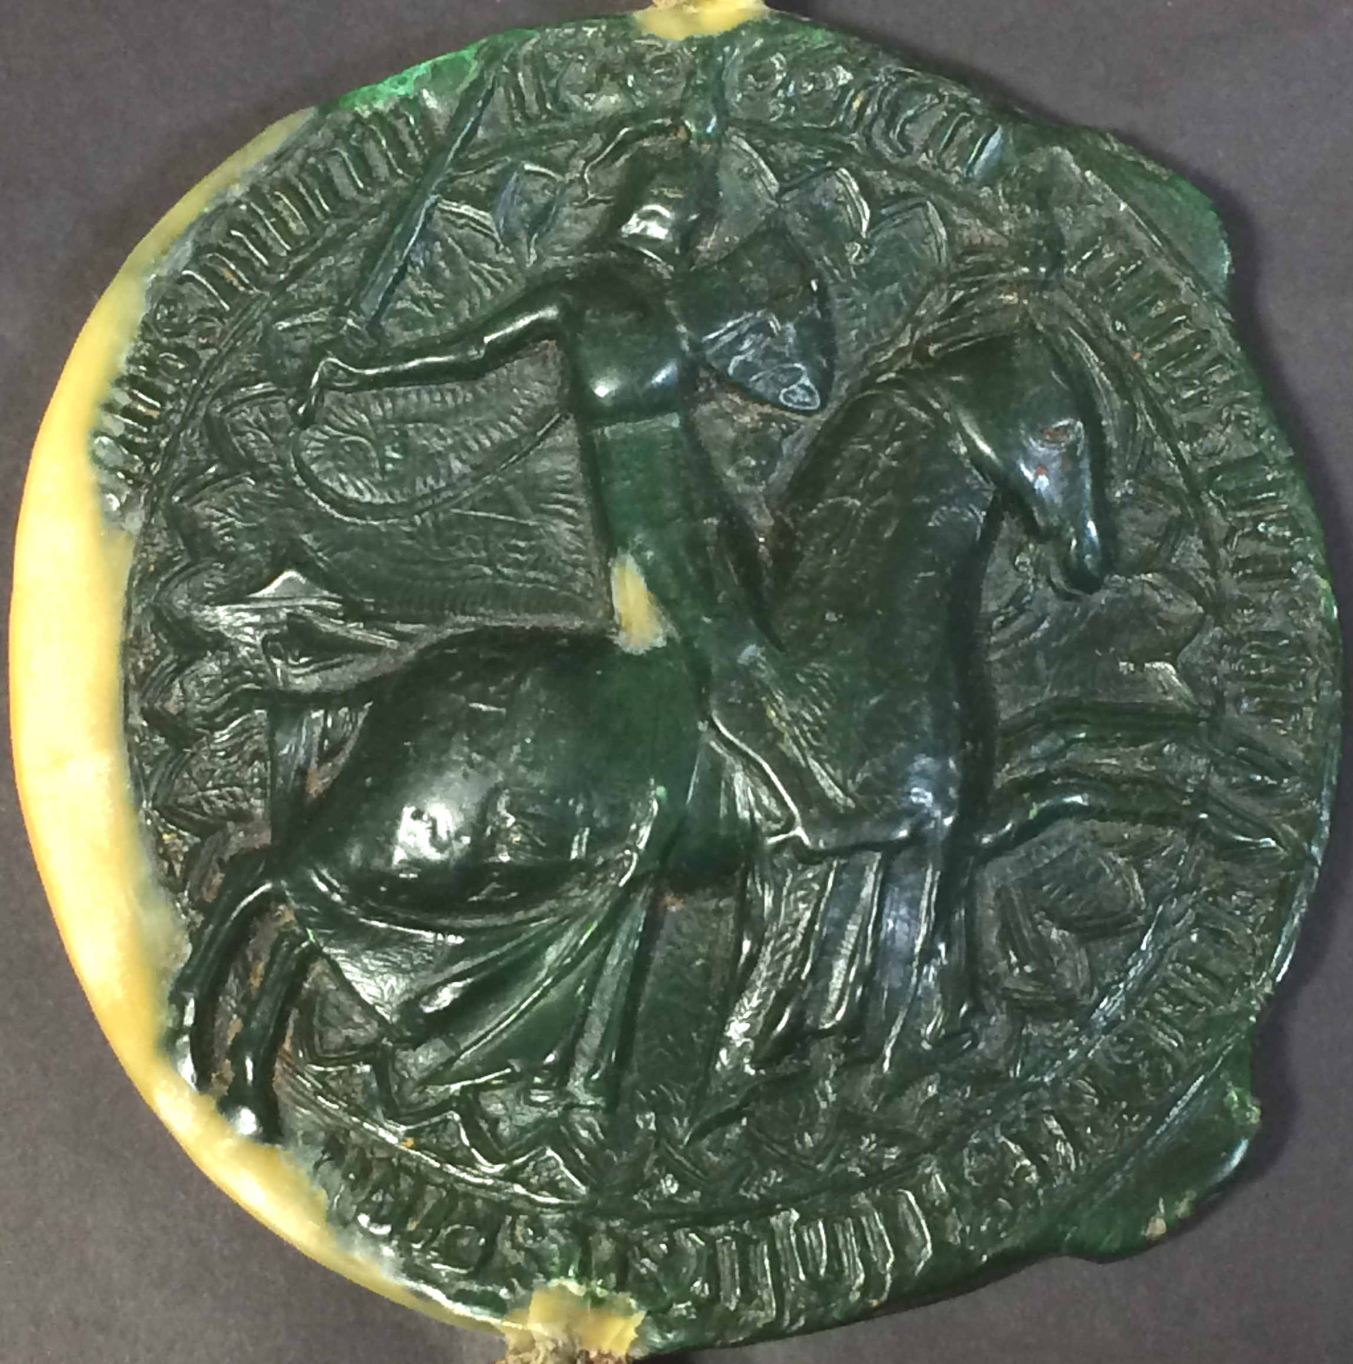
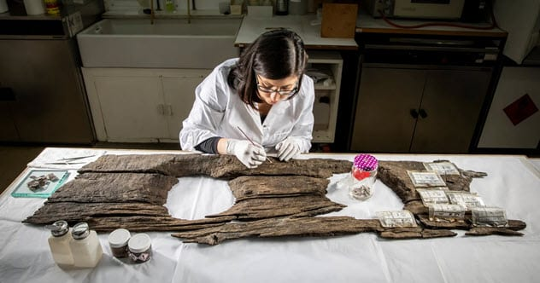
A dice used for gambling
Henry V’s ‘Great Seal’
Do you know the dates for the Medieval period?
A brooch
Medieval water bottles!
c.500-1450!
A 3 person toilet
1.
3.
4.
2.
5.
Expert historian question: Which of these objects do you think was most precious to medieval people? Think carefully!

Slide 6
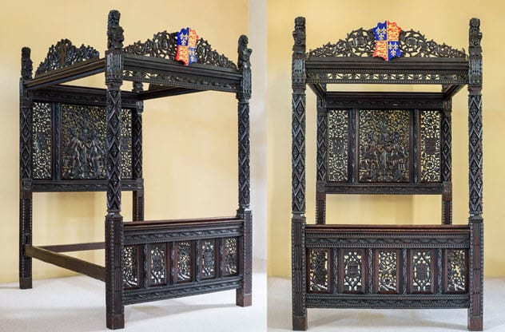
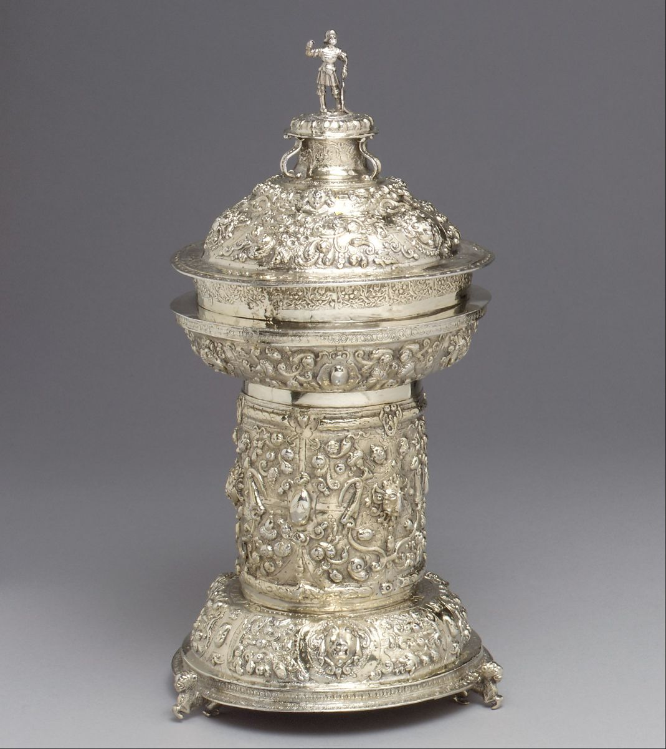
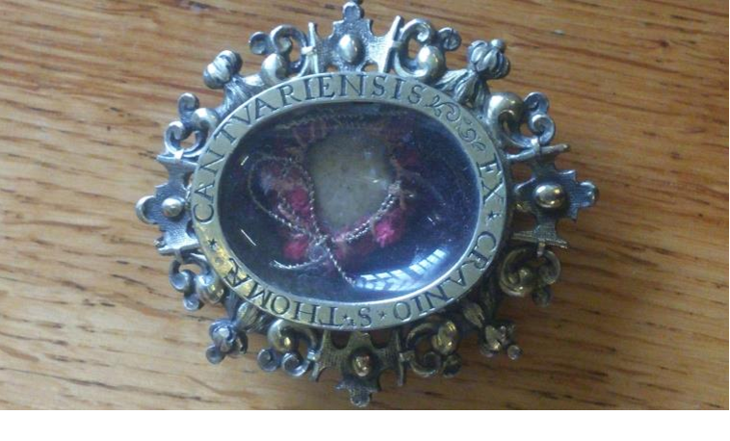
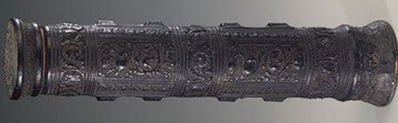
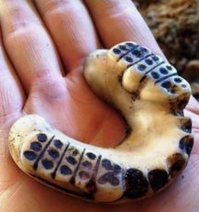
A container for holy relics
Do you know the dates for the Early Modern period?
Ivory teeth dentures (fake teeth!)
1500-1700!
A royal bed
A scroll holder
A container for salt
1.
3.
5.
2.
4.
Expert historian question: The salt cellar is very fancy, so what might that tell us about salt?

Slide 7
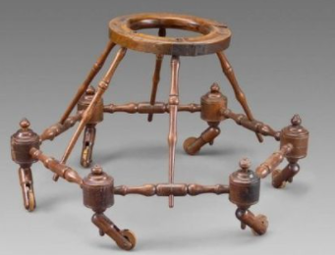
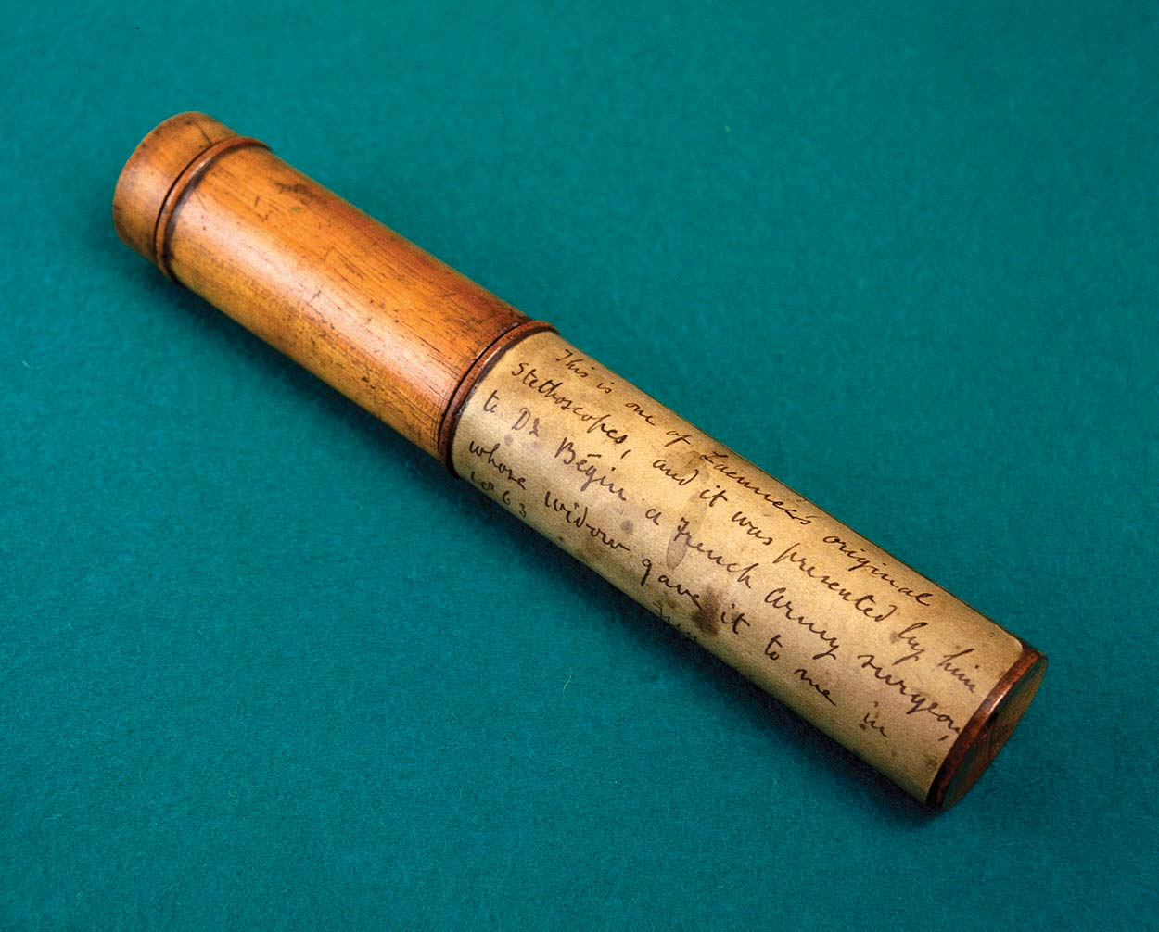
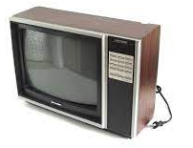
A telescope
Do you know the dates for the Modern period?
A cup used to drink wine from
A baby walker
A television from the 1980s
1700-Present day!
A stethoscope
1.
3.
5.
2.
4.
Expert historian question: What do these objects tell us about what was important to people in the Modern period?

Slide 8
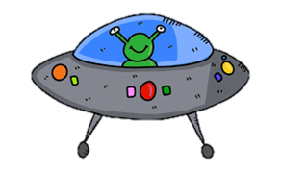
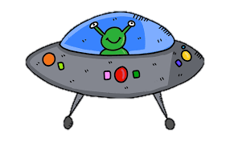
Competition!!!!!
We would like you to create your own time capsule showing a visitor from outer space what life is like on Earth in 2021.
You need to select either take photographs or upload images of objects you choose and explain why you have chosen that particular object to help explain what life is like on Earth. You may want to think about including:
Technology you use
Favourite foods
Places you visit
What your school is like
How you like to dress
Everyday objects
Make it as interesting, creative and informative as you can and then upload it to the portal!
COMPETITION TASK !!!
TAKE A PHOTO OF YOUR TIME CAPSULE AND CLICK HERE TO UPLOAD IT TO THE PORTAL TO WIN A FREE BREAKFAST AND TO ENTER THE PRIZE DRAW !!!

Slide 9
Thank you for joining us on our hunt through the time capsules-we hope you enjoyed exploring the past together.
We look forward to welcoming you to the History department in September!

